Slide 1
1
( Practical Molecular Biology
)
20 8 20 9
ؤ
1 -
1
ac R
lac.Raghad Ibrahim
l
.
Laboratory () Electrolysis of polyacrylamide gel electrophoresis
(PAGE)
Propagation of proteins is the same as the general method for separating DNA, but here using polycrylmide instead of acroose, where polycrymide is formed from bis acrylmide, 30 mgacrylmide 0.8 mg, dissolved in 5 ml of electrical relay chamber(
Acrylamide replicates with another material. The crosslinker is called bisacrylamide, which produces a differentiated gel medium that varies according to the concentration of the electrolyde (T) and the concentration of the clamp (C). This gel is not solid at room temperature, so add a substance It is known as Ammonium per sulfate. Acrylamide is pre- polymerized as toxic, so be careful when dealing with it and wearing paws and not inhaling.
The transfer unit is vertical and the gel is placed between two glass plates or in special tubes with upper and lower storage tanks where the alkaline solution is placed. A multi-acrylamide gel is used to prepare or define the DNA molecules with a low molecular weight (less than 1 kilo) long, To determine the efficiency of the techniques used in extraction and purification, determine the molecular weight or to set the electric breakout point and the protein is pigmented after the completion of the migration by the dye Coomassie Brilliant Blue 250, which gives protein packets blue color and the migration of proteins is divided into two types depending on Alpferat used type:
A) Relocation to a similar upper and lower regulator.
B - deportation with a different upper and lower organizer
-Attention should be paid to the air bubbles during preparation
Ammonium persulfite is added during polymerization (APS, acrylmide, perlite), which when
combined with water generates free discharges, activates polymerization, bubbles inhibit
active shipments of polymerization.
The dye should be used later
The differences between electrodermabrasion and DNA are protein
.١In DNA, the bromide is added to the final concentration (0.5 μg / ml) before
polymerization of 60 ° C, which is later seen in UV, whereas in the sample protein it is mixed with the SDS detergent (1-4 g / g polypeptide) and heated to 100 degrees A percentage of the polypeptide treatment and making it negative shipping and linear and straight.
.٢In the DNA samples, take 25 mg of bromo phenol, 4 mg sucrose and add water to 10 ml and save at 4 ° C. To see the samples, move the gel in the naked eye. In the protein, after the migration is complete, It is placed in a box containing the dye containing chromosome bromo phenol blue to dye and shake or move to the very appearance of the packages and wash with the water of a bivalve to get rid of excessive dye
Experiment / migrate samples of DNA in a polyacrylamide gel

Slide 2
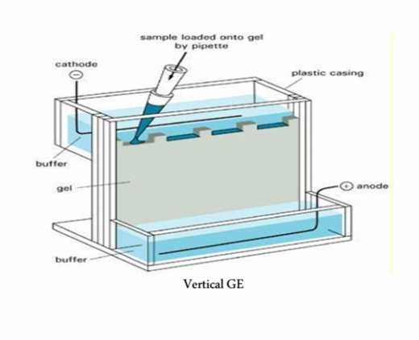
2
( Practical Molecular Biology
)
20 8 20 9
ؤ
1 -
1
ac R
lac.Raghad Ibrahim
l
.
Materials:
Polyacrylamid gel, d H2O, Ammonium per sulfate, TEB, Temed
The method of work
`1Polyacrylamid gel: Prepare 40 ml (w / v) of Polyacrylamid by (1.99) (acrylamide:
bisacrylamide). Take this preparation (ml15). Add 15 mL of TEB solution (5X), ml20 of d
H2O, 800 μl (10%) (w / v) of 80 μl Ammonium per sulfate of Temed) and use a solvent
solution (X 1.5) of TBE during the electrical transfer process.
2Take 6 ml of polyacrylamide mixture at 40% concentration and mix with 6 mL of TBE (X5).
Add 4 ml of dH2O and mix with 1 μl160 of ammonium per su

Slide 3
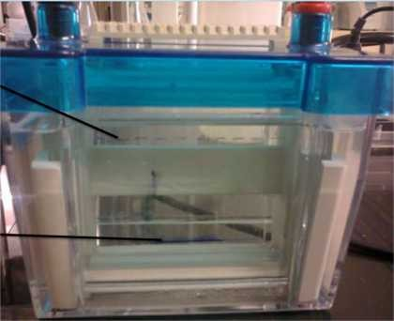
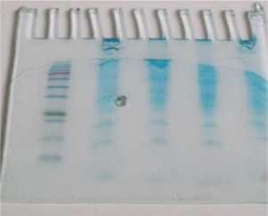
3
( Practical Molecular Biology
)
20 8 20 9
ؤ
1
-
1
ac R
lac.Raghad Ibrahim
l
.
AFTER SLECTROPHPRESIS

